Slide 1

Network-Centric Distributed Tracing with DeepFlow:
Troubleshooting Your Microservices in Zero Code
Published in SIGCOMM 2023
Presented by：罗林丰

Slide 2

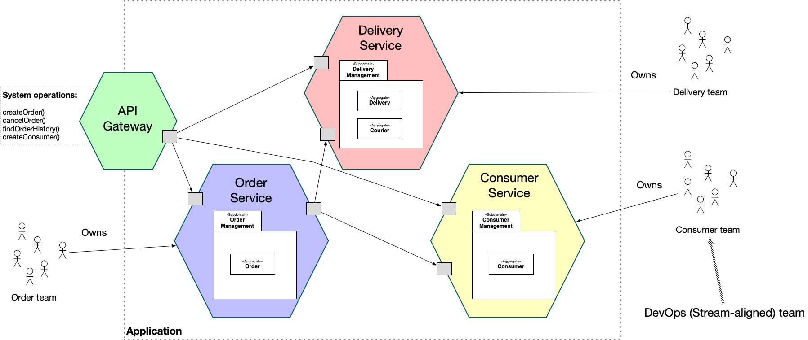
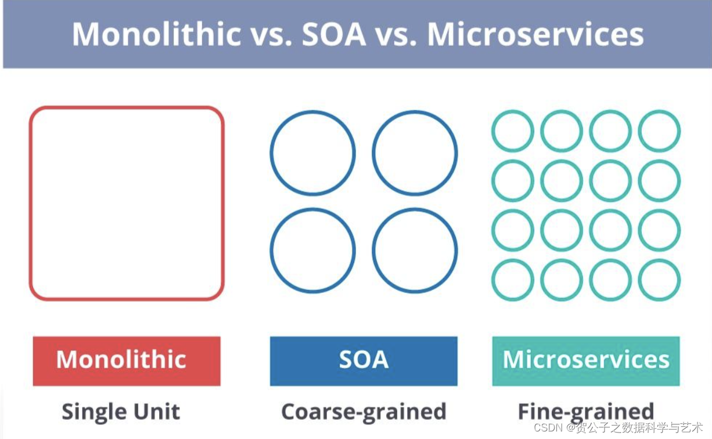
Microservices
Microservices - also known as the microservice architecture - is an architectural style that structures an application as a collection of services that are:
Independently deployable
Loosely coupled
Services are typically organized around business capabilities. Each service is often owned by a single, small team.
Tsinghua University of China
Central South University

Slide 3
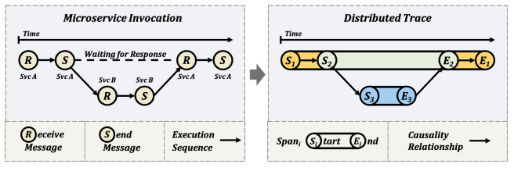
Distributed Tracing
Google published a paper titled "Dapper, a Large-Scale Distributed Systems Tracing Infrastructure" in April 2010, introducing the concept of distributed tracing:
Trace is a transaction supported by the collaboration of distributed microservices, encompassing various service requests serving that transaction;
Span is a workflow within a transaction, containing timestamps, logs, and label information. Spans have parent-child relationships or follow-up relationships between them;
Span Context is crucial for supporting distributed tracing, allowing the passage of information between services.
Distributed tracing is a technique for monitoring and tracking interactions between components in Microservices.
Tsinghua University of China
Central South University

Slide 4
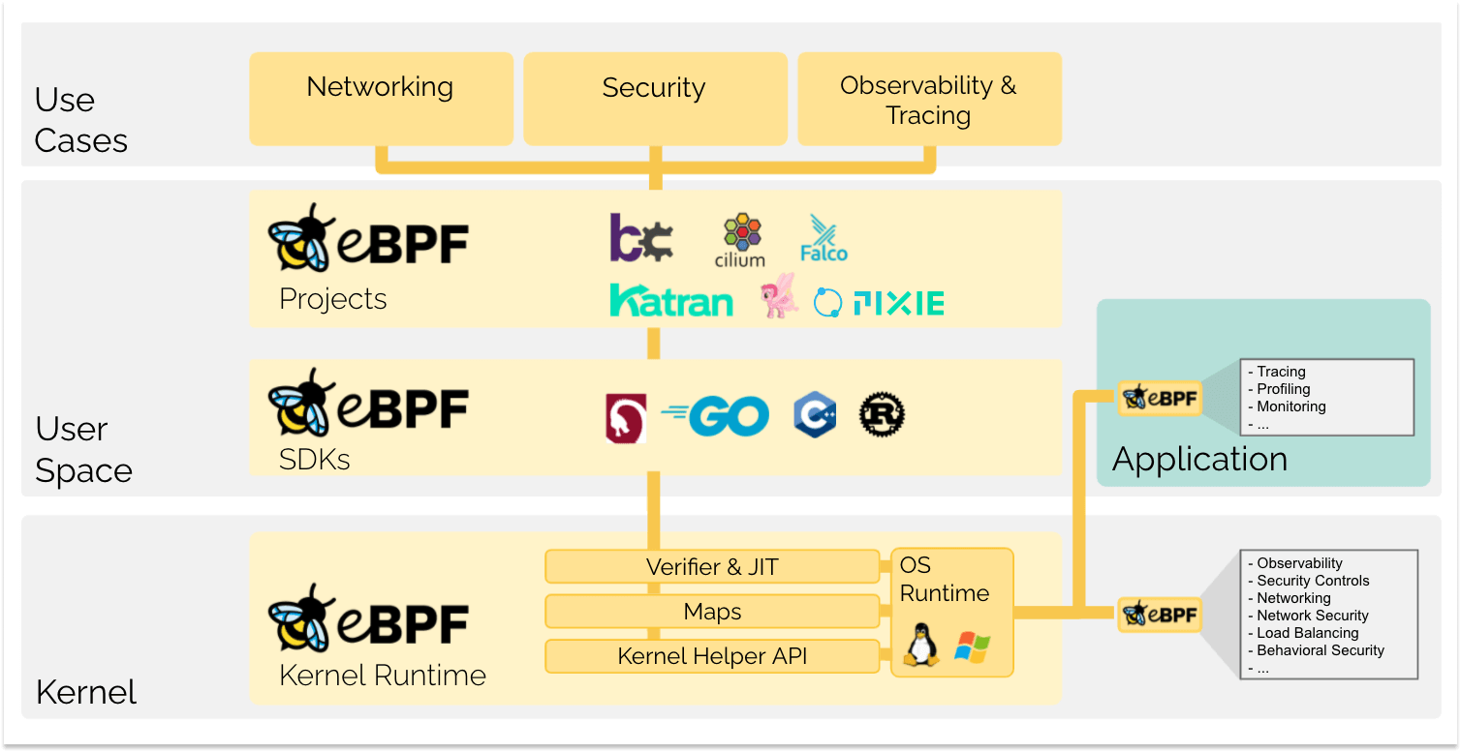
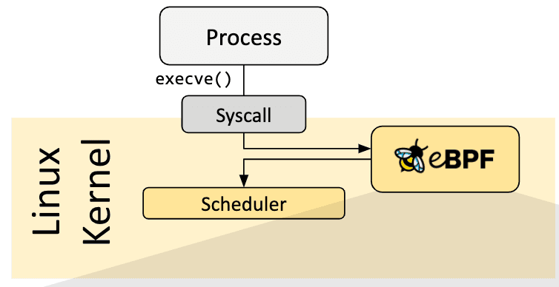
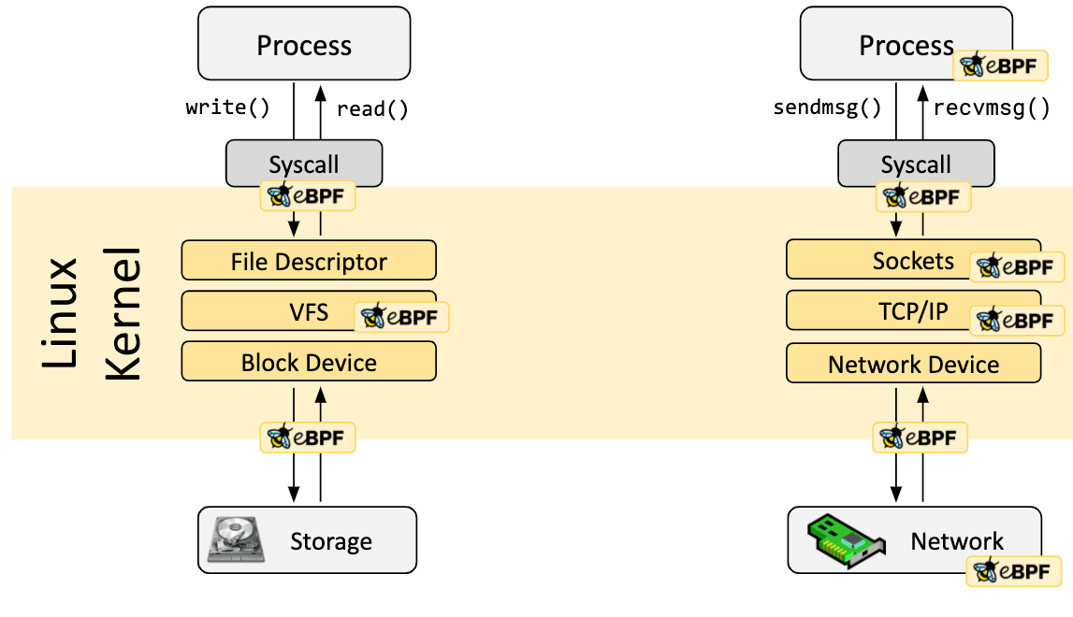
eBPF
eBPF is a technology with origins in the Linux kernel that can run sandboxed programs in a privileged context such as the operating system kernel. It is used to safely and efficiently extend the capabilities of the kernel without requiring to change kernel source code or load kernel modules.
What is eBPF?
eBPF programs are event-driven and are run when the kernel or an application passes a certain hook point.
If a predefined hook does not exist for a particular need, it is possible to create a kernel probe (kprobe) or user probe (uprobe) to attach eBPF programs almost anywhere in kernel or user applications.
Tsinghua University of China
Central South University

Slide 5
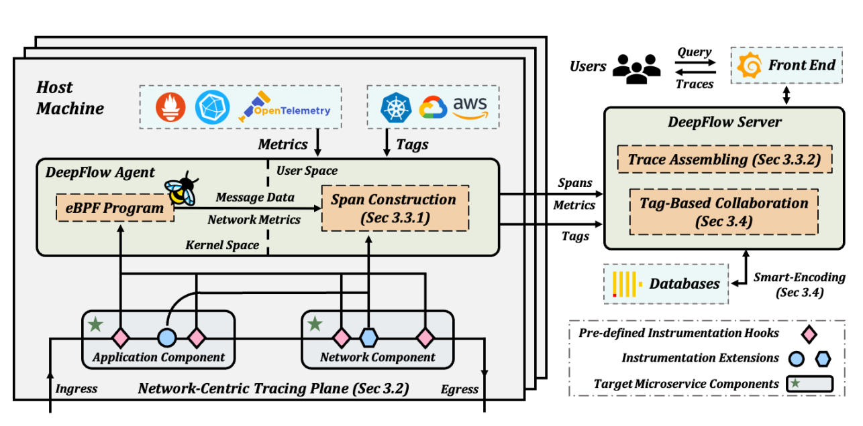
Contributions
The three design aspects of DeepFlow: network-centric tracing plane, implicit context propagation and tagbased correlation.
This paper introduces DeepFlow, a distributed tracing framework intended
specifically for microservices. DeepFlow facilitates both out-ofthe-box tracing and rapid performance problem location.
DeepFlow has already identified over 71 critical performance anomalies for more than 26 companies and has been utilized by hundreds of individual developers.
Tsinghua University of China
Central South University

Slide 6
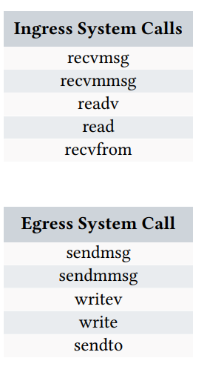
Network-Centric Tracing Plane
Design 1: A narrow-waist instrumentation model with two sets of functions: ingress-egress and enter-exit:
DeepFlow selects ten system call application binary interfaces (ABIs) as the basic instrumentation points, and classifies them as ingress or egress. .
DeepFlow stores information about each ingress or egress call as it enters or exits the kernel:
Program information: including process ID, thread ID, coroutine ID, program name;
Network information: including the DeepFlow assigned global unique socket ID, five-tuple, the TCP sequence;
Tracing information: including data capture timestamp, ingress/egress direction;
System call information: the total length of read/write data, payload to be transferredto the DeepFlow agent.
Tsinghua University of China
Central South University

Slide 7
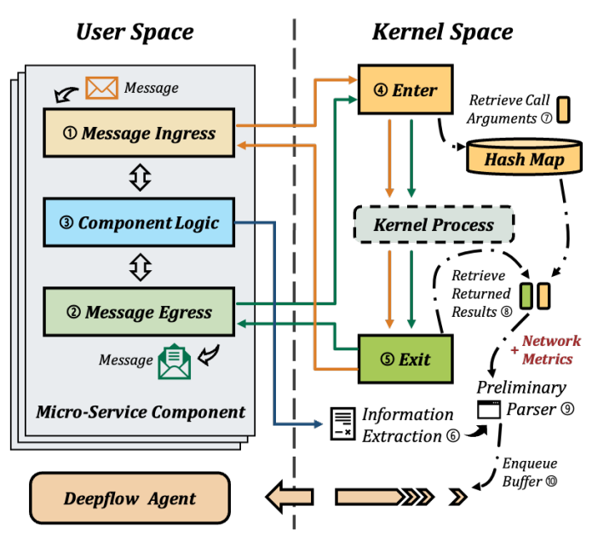
Network-Centric Tracing Plane
Design 2: In-kernel hook-based Non-Intrusive instrumentation:
In accordance with the pre-defined instrumentation model, DeepFlow automatically registers hooks to collect trace data.
The kernel privileges permit DeepFlow to access information (e.g., message content, TCP sequence, socket flags, etc.) at multiple network layers of different components.
Since eBPF programs can directly monitor any on-the-fly programs, DeepFlow can be deployed in zero code at any time, and users no longer need to restart active online microservices.
Tsinghua University of China
Central South University

Slide 8
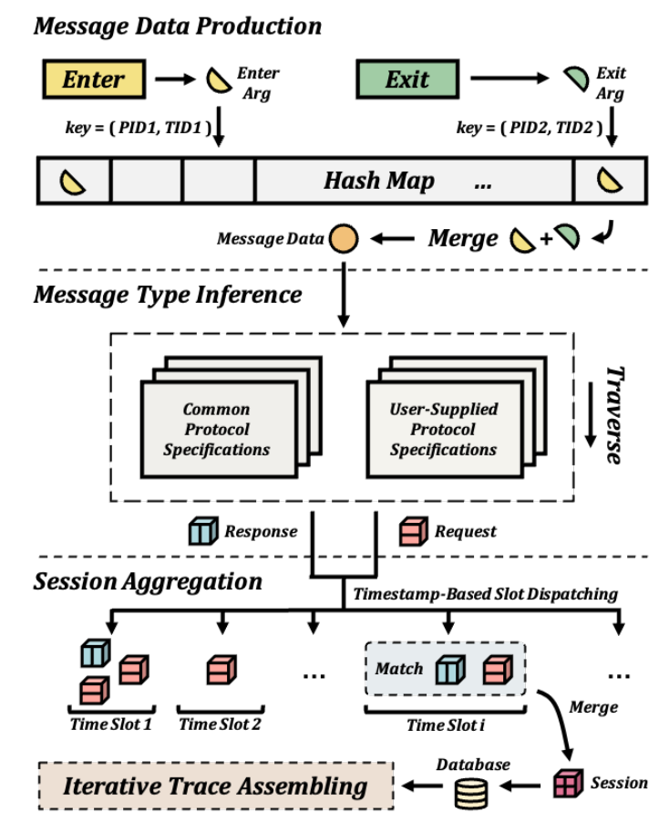
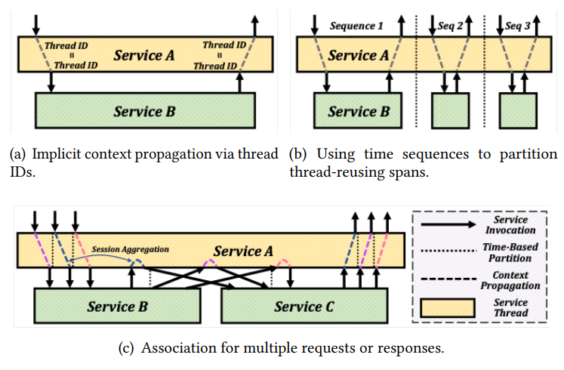
Implicit Context Propagation
Design 3: Implicit context propagation with hierarchical aggregation:
DeepFlow combines independent, fragmented, and primitive measurements into request-oriented traces containing precise causal correlations through the following two phases:
Constructing spans from the instrumentation data;
Assembling traces from spans using implicit causal relationships.
Tsinghua University of China
Central South University

Slide 9
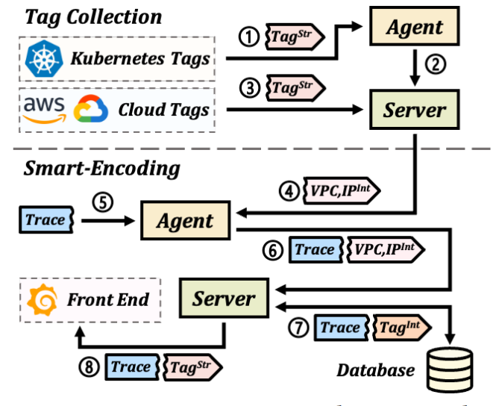
Tag-Based Correlation
To achieve cross-component correlation in zero code, DeepFlow injects uniform tags into the spans.
DeepFlow enable the injection of Kubernetes resource tags, self-defined labels, and cloud resource tags.
Users can use these tags to immediately determine the locations of the problems.
Design 4: Smart-encoding based on phased tag injection
By partitioning the tag injection phases, DeepFlow reduces the calculation, transmission, and storage overhead.
Tsinghua University of China
Central South University

Slide 10
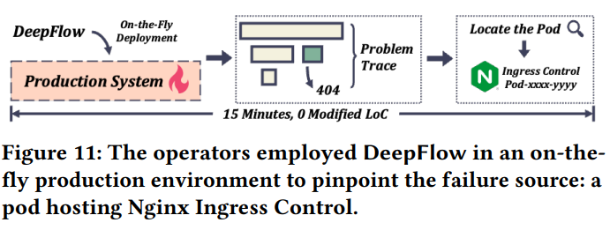
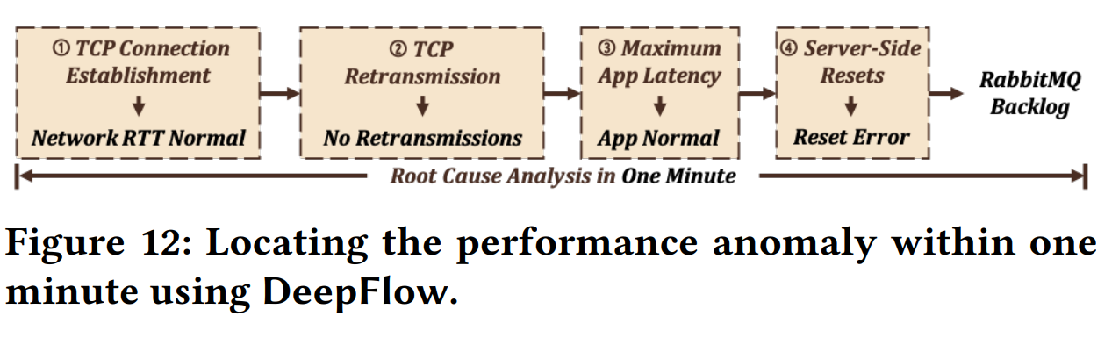
Experiments and Results
Without modifying a single line of code, operators deploy DeepFlow while the service is active and obtain hop-by-hop network data in the traces collected.
After ruling out problems in the containers, virtual machines, and virtual switches, we discover that the redundant ARP requests are generated by a malfunctioning physical NIC.
Cross-layer correlation distinguishes DeepFlow from other tracing frameworks.
Tsinghua University of China
Central South University

Slide 11
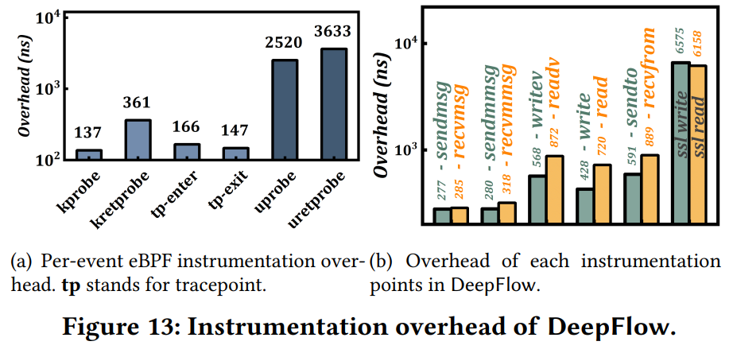
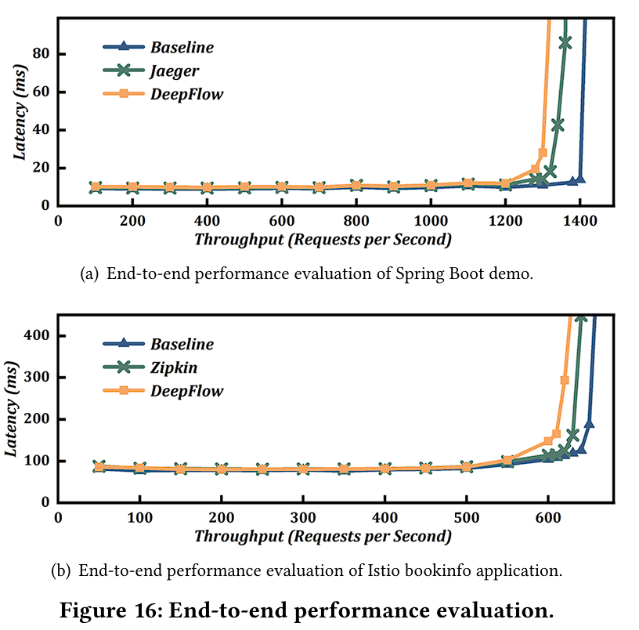
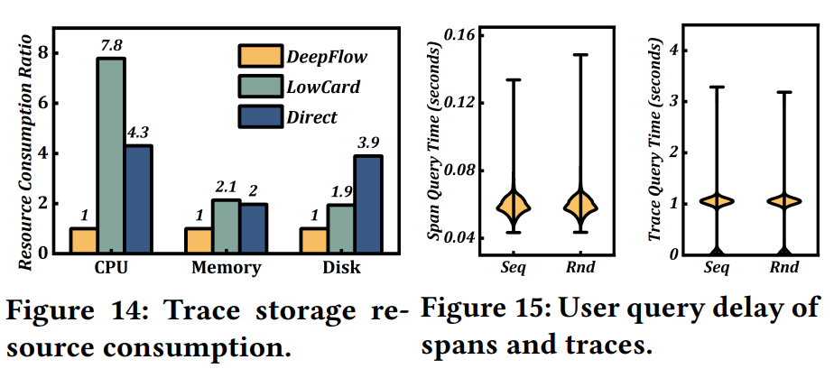
Experiments and Results
Tsinghua University of China
Central South University

Slide 12
Reflection
Network Anomalies Diagnosis in Real Environment
eBPF
Network Cross-Layer Monitoring
Tsinghua University of China
Central South University

Slide 13
Thanks you ！

